Slide 1
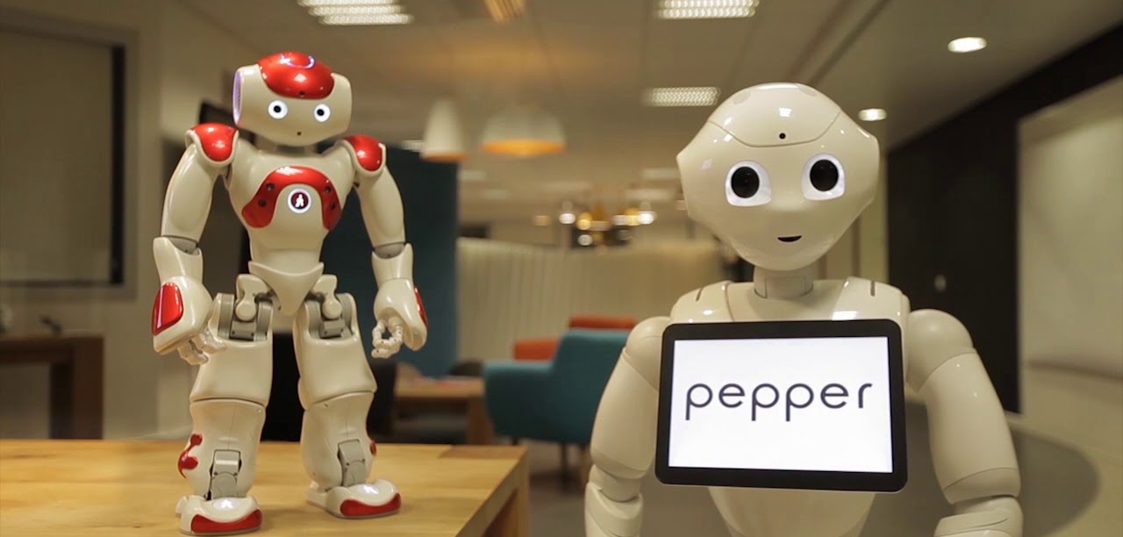
NAO and Pepper
Introduction tutorial

Slide 2
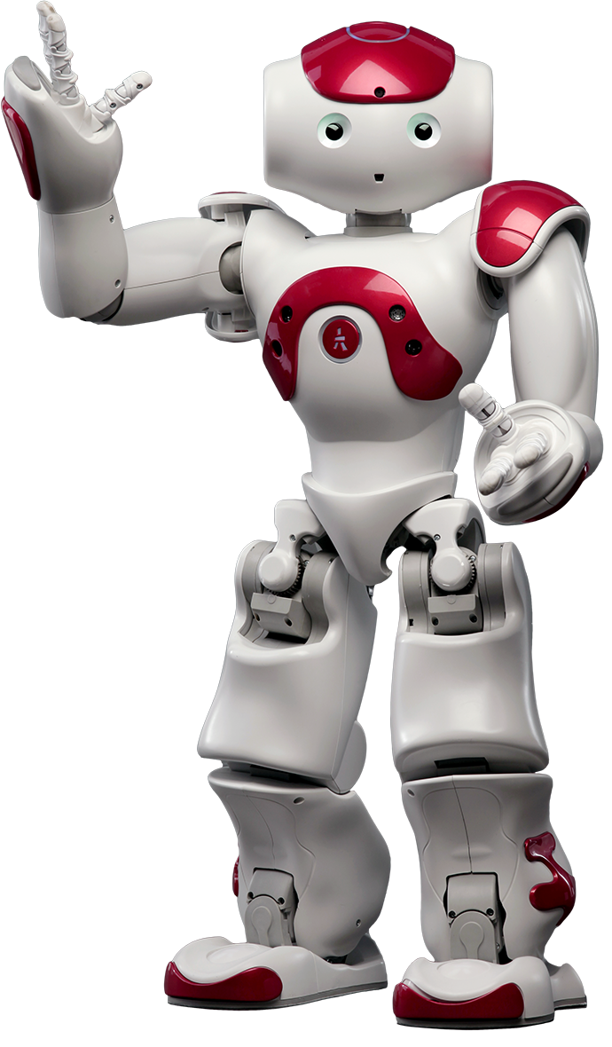
The NAO Robot
60-cm tall humanoid robot
We have one available

Slide 3
Working with NAO
Carry NAO at the waist
Before switching on the robot: plug in the router
Chest button
On (1 press) “OGNAK GNOUK”
Off (4 seconds) “GNOUK GNOUK”
When on (1 press) “Hello, I am NAO. My internet address is … + Status notifications”
When on (2 press) Switch on/off autonomous life or stiffness

Slide 4
Working with NAO
While testing:
Always place the robot on the floor!
Be there to catch it
Charger goes in the back

Slide 5
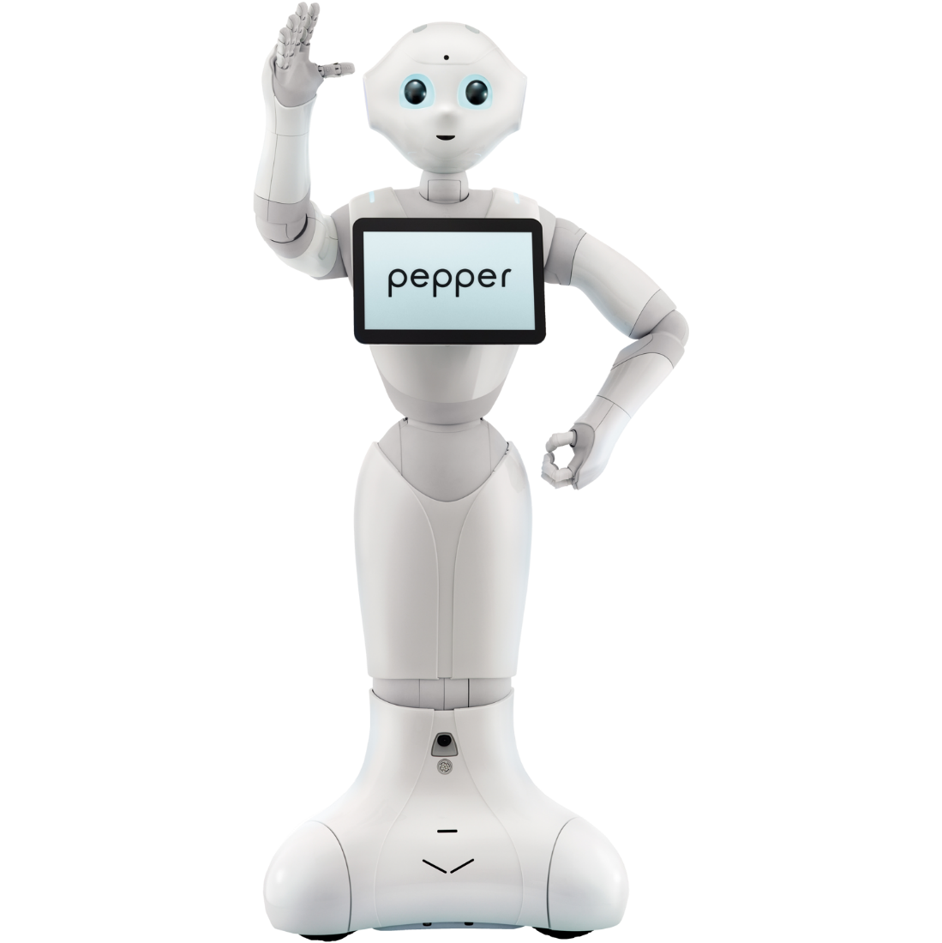
Pepper robot
120-cm tall humanoid robot
We have one available

Slide 6
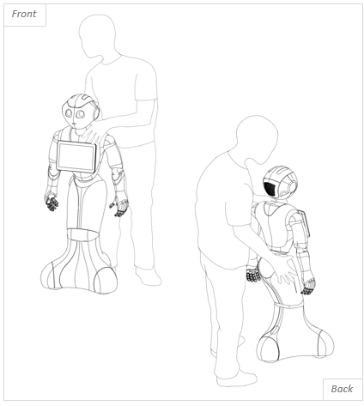
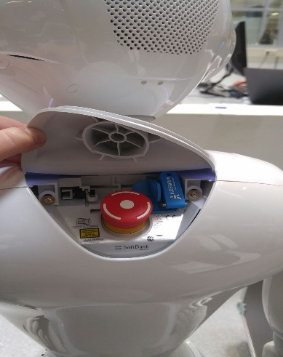
Working with Pepper
Preferable only move Pepper when it’s turned off
One hand on the hip and one on the shoulder
If it is turned on, only move in ‘crouch’ mode and with power hatch open
Chest button
On (1 press) “OGNAK GNOUK”
Off (4 seconds) “GNOUK GNOUK”
When on (1 press) “Hello, I am Pepper. My internet address is … + Status notifications”
When on (2 press) Switch on/off autonomous life
Emergency turn off: Red button in neck

Slide 7
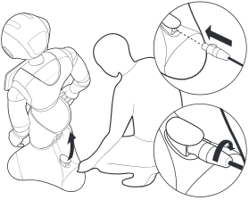
Working with Pepper
While testing:
Make sure Pepper has enough space to move around
Charger goes in the foot, turn the charger right until it clicks

Slide 8

Choregraphe demo
Connect
Autonomous life
Behaviours (adjust code)
Timeline

Slide 9
Finding and reserving the robots
The robots are in the ADS&AI Staff offices
Find them there in the morning and make sure to put them back before 17:00h!

Slide 10
Support
Send an email/teams message to me (neggers.m@buas.nl)
A lot of information can be found here:
http://doc.aldebaran.com/2-4/index.html

Slide 11
Goal
Develop an application with an interaction between a human and a robot

Slide 12
Extra Notes
Connect your pc with the provided router to access the robot
This router is not connected to the internet
The robots are located in the staff only room, this room is past room 2.010 (classroom from block b) then around the corner. You need your student card to open the door, the robots should be immediately on your left.
Deliverables:
All the Choregraphe files we will make.
A logbook comparable to the working log. (individually)
We can also make a big project as a group and video evidence it etc. but nothing is required we just have to show that we messed around with the robot and the program

